Slide 1

FP7. Robot learning techniques for set point regulation of robots with nonlinear flexibility on the joints Underactuated Robotics 2020-2021
Caciolai Andrea Nicotra Emanuele Rabbiolo Matilde Dora
Proff.: G.Oriolo – L.Lanari
Sup.: Marco Capotondi

Slide 2
Introduction
Problem: Set-point regulation of a manipulator with flexible joints with unknown nonlinear joint elasticity
Solution: MPC combined with learning techniques
Outline:
Introduction of the mathematical model of the system
Underactuation of the model (unknown elastic term)
Nonlinear MPC
Learning techniques (GP)
Simulation setting
Simulation results (MPC + GP)

Slide 3
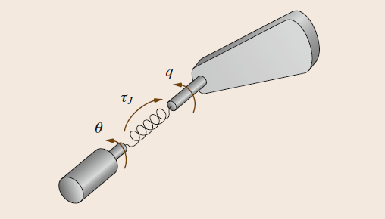
Robot with flexible joints
Robot with N revolute elastic joints
Motor variables
Link variables
2N generalized coordinates

Slide 4
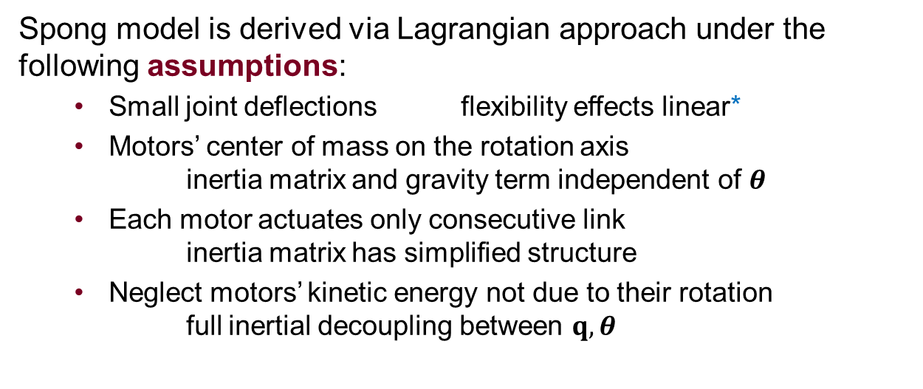
Robot with flexible joints Spong model
Spong model is derived via Lagrangian approach under the following assumptions:
Small joint deflections flexibility effects linear*
Motors’ center of mass on the rotation axis inertia matrix and gravity term independent of $θ$
Each motor actuates only consecutive link inertia matrix has simplified structure
Neglect motors’ kinetic energy not due to their rotation full inertial decoupling between $q, θ$
*: in our project we assume nonlinear (unknown) elastic term

Slide 5
Robot with flexible joints Spong model
Potential energy due to gravity and joint elasticity
Kinetic energy
Assumption 4

Slide 6
Robot with flexible joints Spong model is underactuated
Dynamical model resulting from Lagrangian approach
Configuration
Control input
Fewer control inputs than dof’s underactuated
System is unconstrained
therefore 2N dof’s
Each elastic joint is actuated

Slide 7
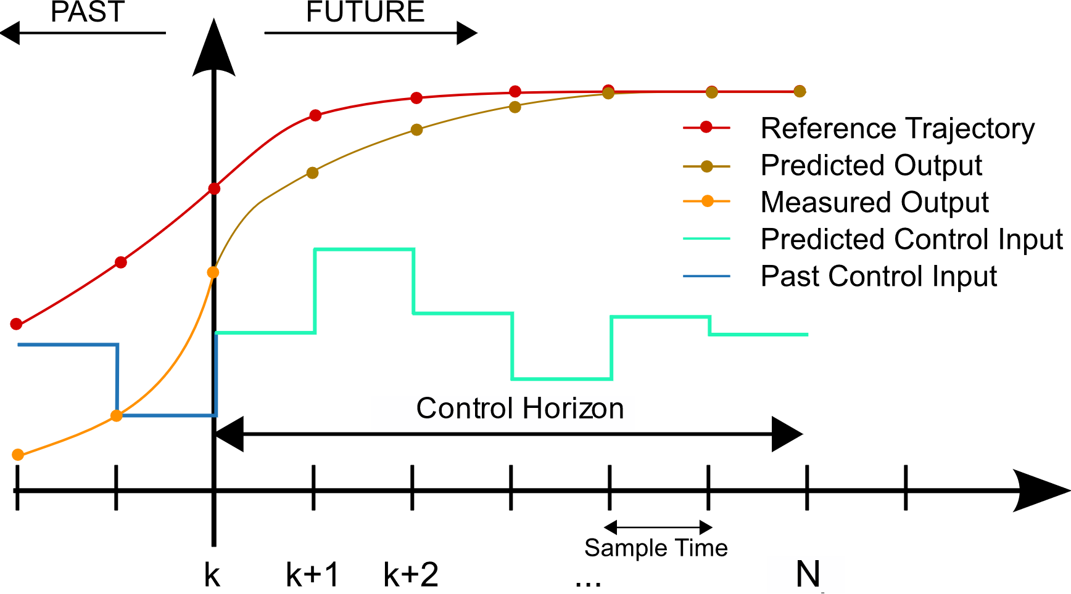
Nonlinear Model Predictive Control (MPC)
MPC solves a finite horizon control problem using the current state of the plant as initial state
Optimal Solution: sequence of control inputs satisfying the constraints while minimizing the corresponding cost function over N steps in the future (Control Horizon).
Control Learning techniques for set point regulation of robots with nonlinear joints flexibility

Slide 8
MPC Formulation
MPC solves the following optimal control problem
Solution to the control problem is the optimal control sequence
Only the first control of the sequence is applied to the plant, and then the resulting state of the plant is used as the new initial state for MPC, that accounts for the deviation (closed-loop behavior)
Cost function
Prediction model
Constraints

Slide 9
Stage Cost
The Stage Cost $l\left(∙\right)$ is defined as
Regulation cost
Velocity damping cost
Smoothness cost

Slide 10
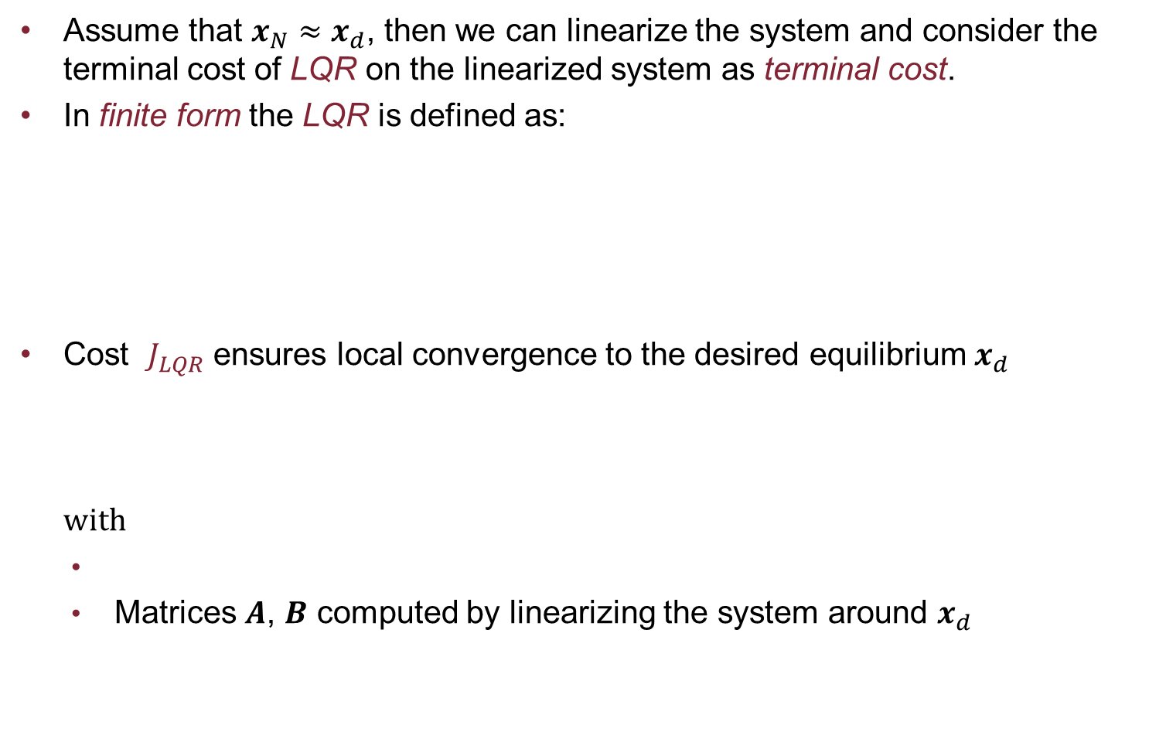
Terminal cost
Assume that $x_{N}≈x_{d}$, then we can linearize the system and consider the terminal cost of LQR on the linearized system as terminal cost.
In finite form the LQR is defined as:
Cost $J_{LQR}$ ensures local convergence to the desired equilibrium $x_{d}$ with
Matrices $A$, $B$ computed by linearizing the system around $x_{d}$
Matrices Q, R symmetric and semi-positive definite

Slide 11
MPC constraints
Bounded torques
Terminal constraint to improve closed loop stability
Overall

Slide 12
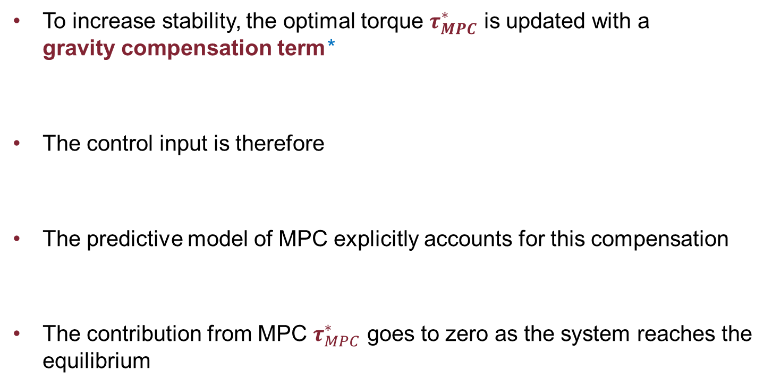
Gravity Compensation
To increase stability, the optimal torque $τ_{MPC}^{∗}$ is updated with a gravity compensation term*
The control input is therefore
The predictive model of MPC explicitly accounts for this compensation
The contribution from MPC $τ_{MPC}^{∗}$ goes to zero as the system reaches the equilibrium
*: P. Tomei, “A simple pd controller for robots with elastic joints,” IEEE Transactions on automatic control, vol. 36, no. 10, pp. 1208–1213, 1991.

Slide 13
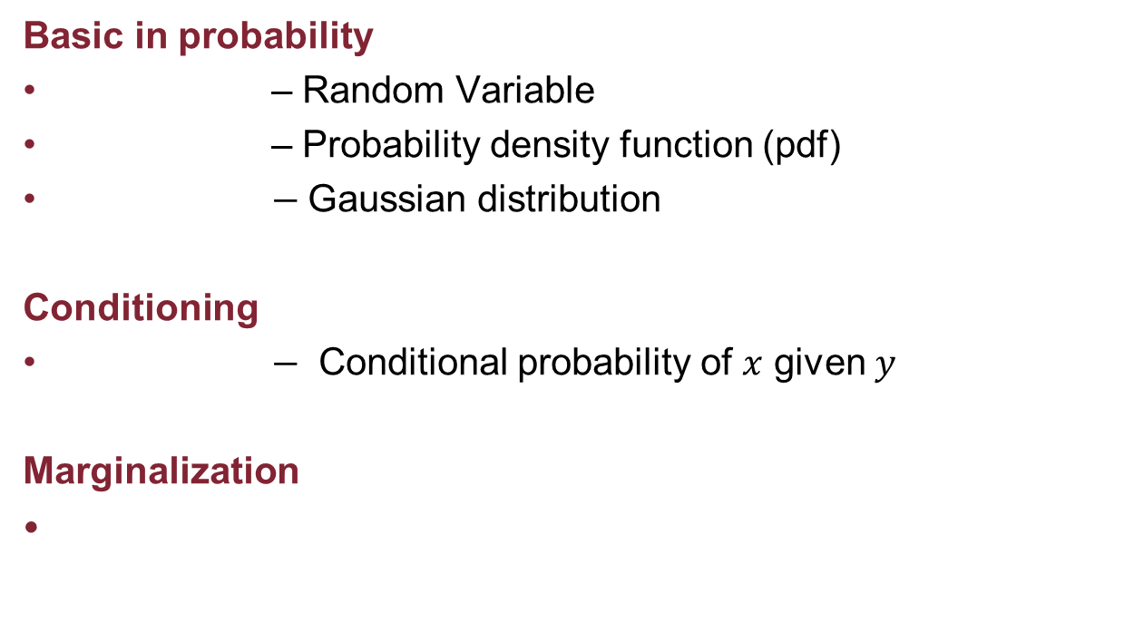
Gaussian Process
Basic in probability
– Random Variable
– Probability density function (pdf)
$−$Gaussian distribution
Conditioning
$−$ Conditional probability of $x$ given $y$
Marginalization

Slide 14
Properties of Gaussian PDF
Gaussian distributions are closed under conditioning and marginalization
Key idea: we want to condition the output y of the
process, given a certain input x, with respect to the data set (X,Y)

Slide 15
Probability density computation
The joint distribution between the training and the test set is a Gaussian distribution
From which we can obtain the conditional distribution using the conditioning operation, in particular its mean and covariance are respectively
With

Slide 16
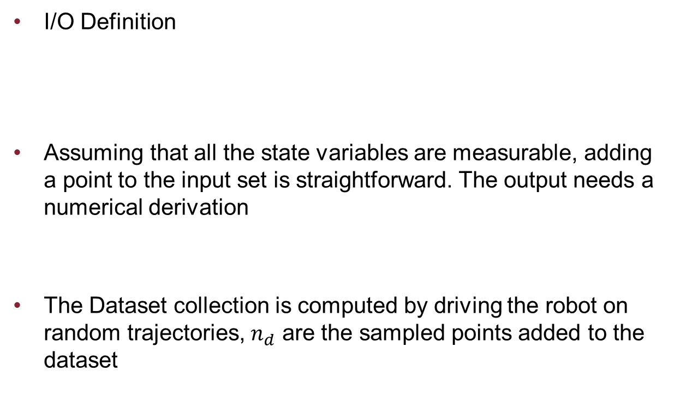
Dataset Definition
I/O Definition
Assuming that all the state variables are measurable, adding a point to the input set is straightforward. The output needs a numerical derivation
The Dataset collection is computed by driving the robot on random trajectories, $n_{d}$ are the sampled points added to the dataset
Euler’s rule

Slide 17
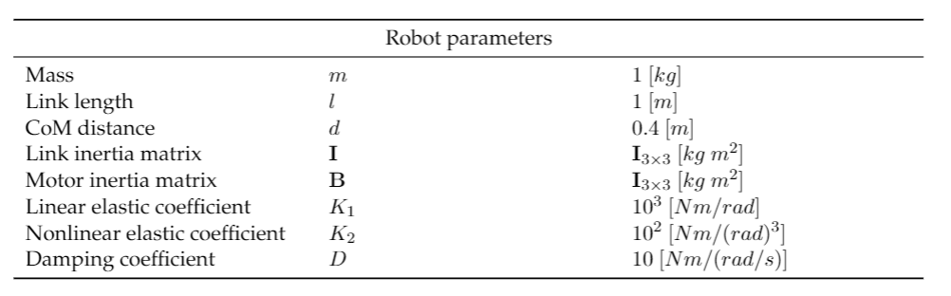
Simulation Settings
The nonlinear elastic term is chosen as
In the simulations with learning, the model is completely known apart from the elastic term, that must be learned by the GP Regressor
Kinematic and dynamic parameters of the robot

Slide 18
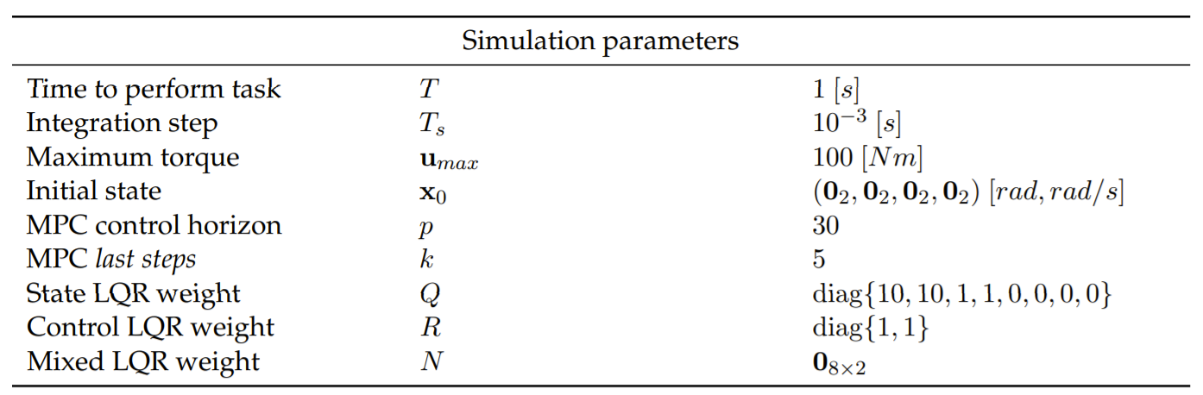
Simulation Settings
To apply the MPC approach, the system is discretized using Euler integration

Slide 19
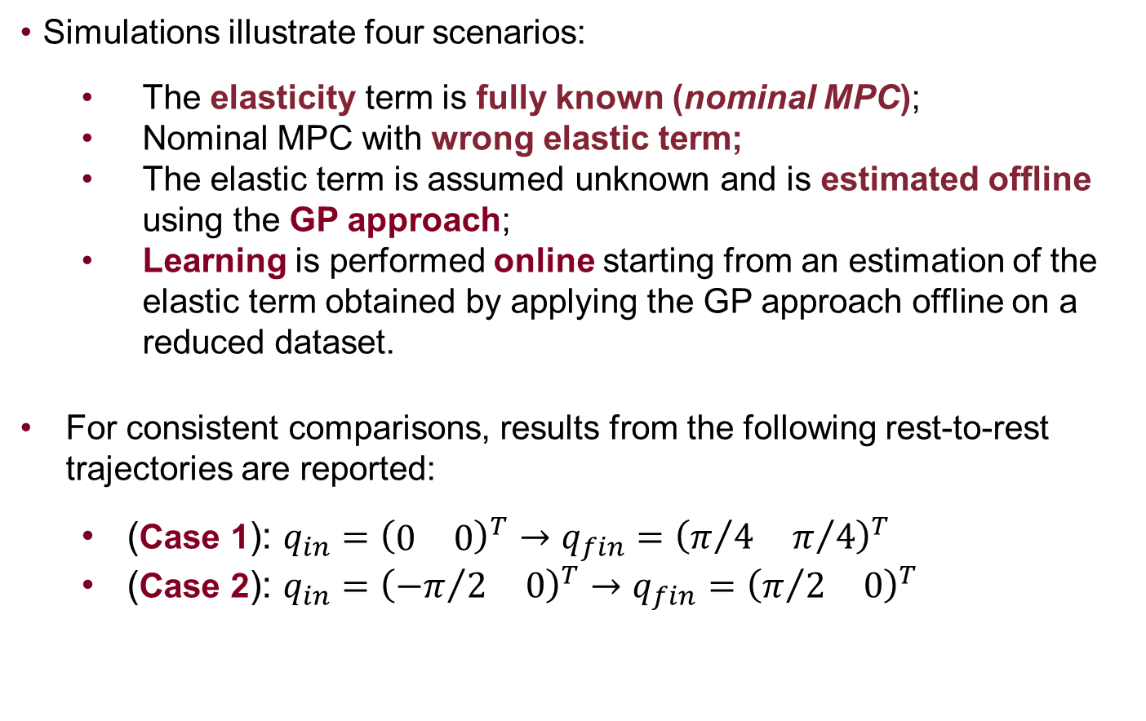
Simulation Results
Simulations illustrate four scenarios:
The elasticity term is fully known (nominal MPC);
Nominal MPC with wrong elastic term;
The elastic term is assumed unknown and is estimated offline using the GP approach;
Learning is performed online starting from an estimation of the elastic term obtained by applying the GP approach offline on a reduced dataset.
For consistent comparisons, results from the following rest-to-rest trajectories are reported:
(Case 1): $q_{in}={\left(\begin{matrix}0 & 0\end{matrix}\right)}^{T}→q_{fin}={\left(\begin{matrix}π/4 & π/4\end{matrix}\right)}^{T}$
(Case 2): $q_{in}={\left(\begin{matrix}{−π}/2 & 0\end{matrix}\right)}^{T}→q_{fin}={\left(\begin{matrix}π/2 & 0\end{matrix}\right)}^{T}$

Slide 20
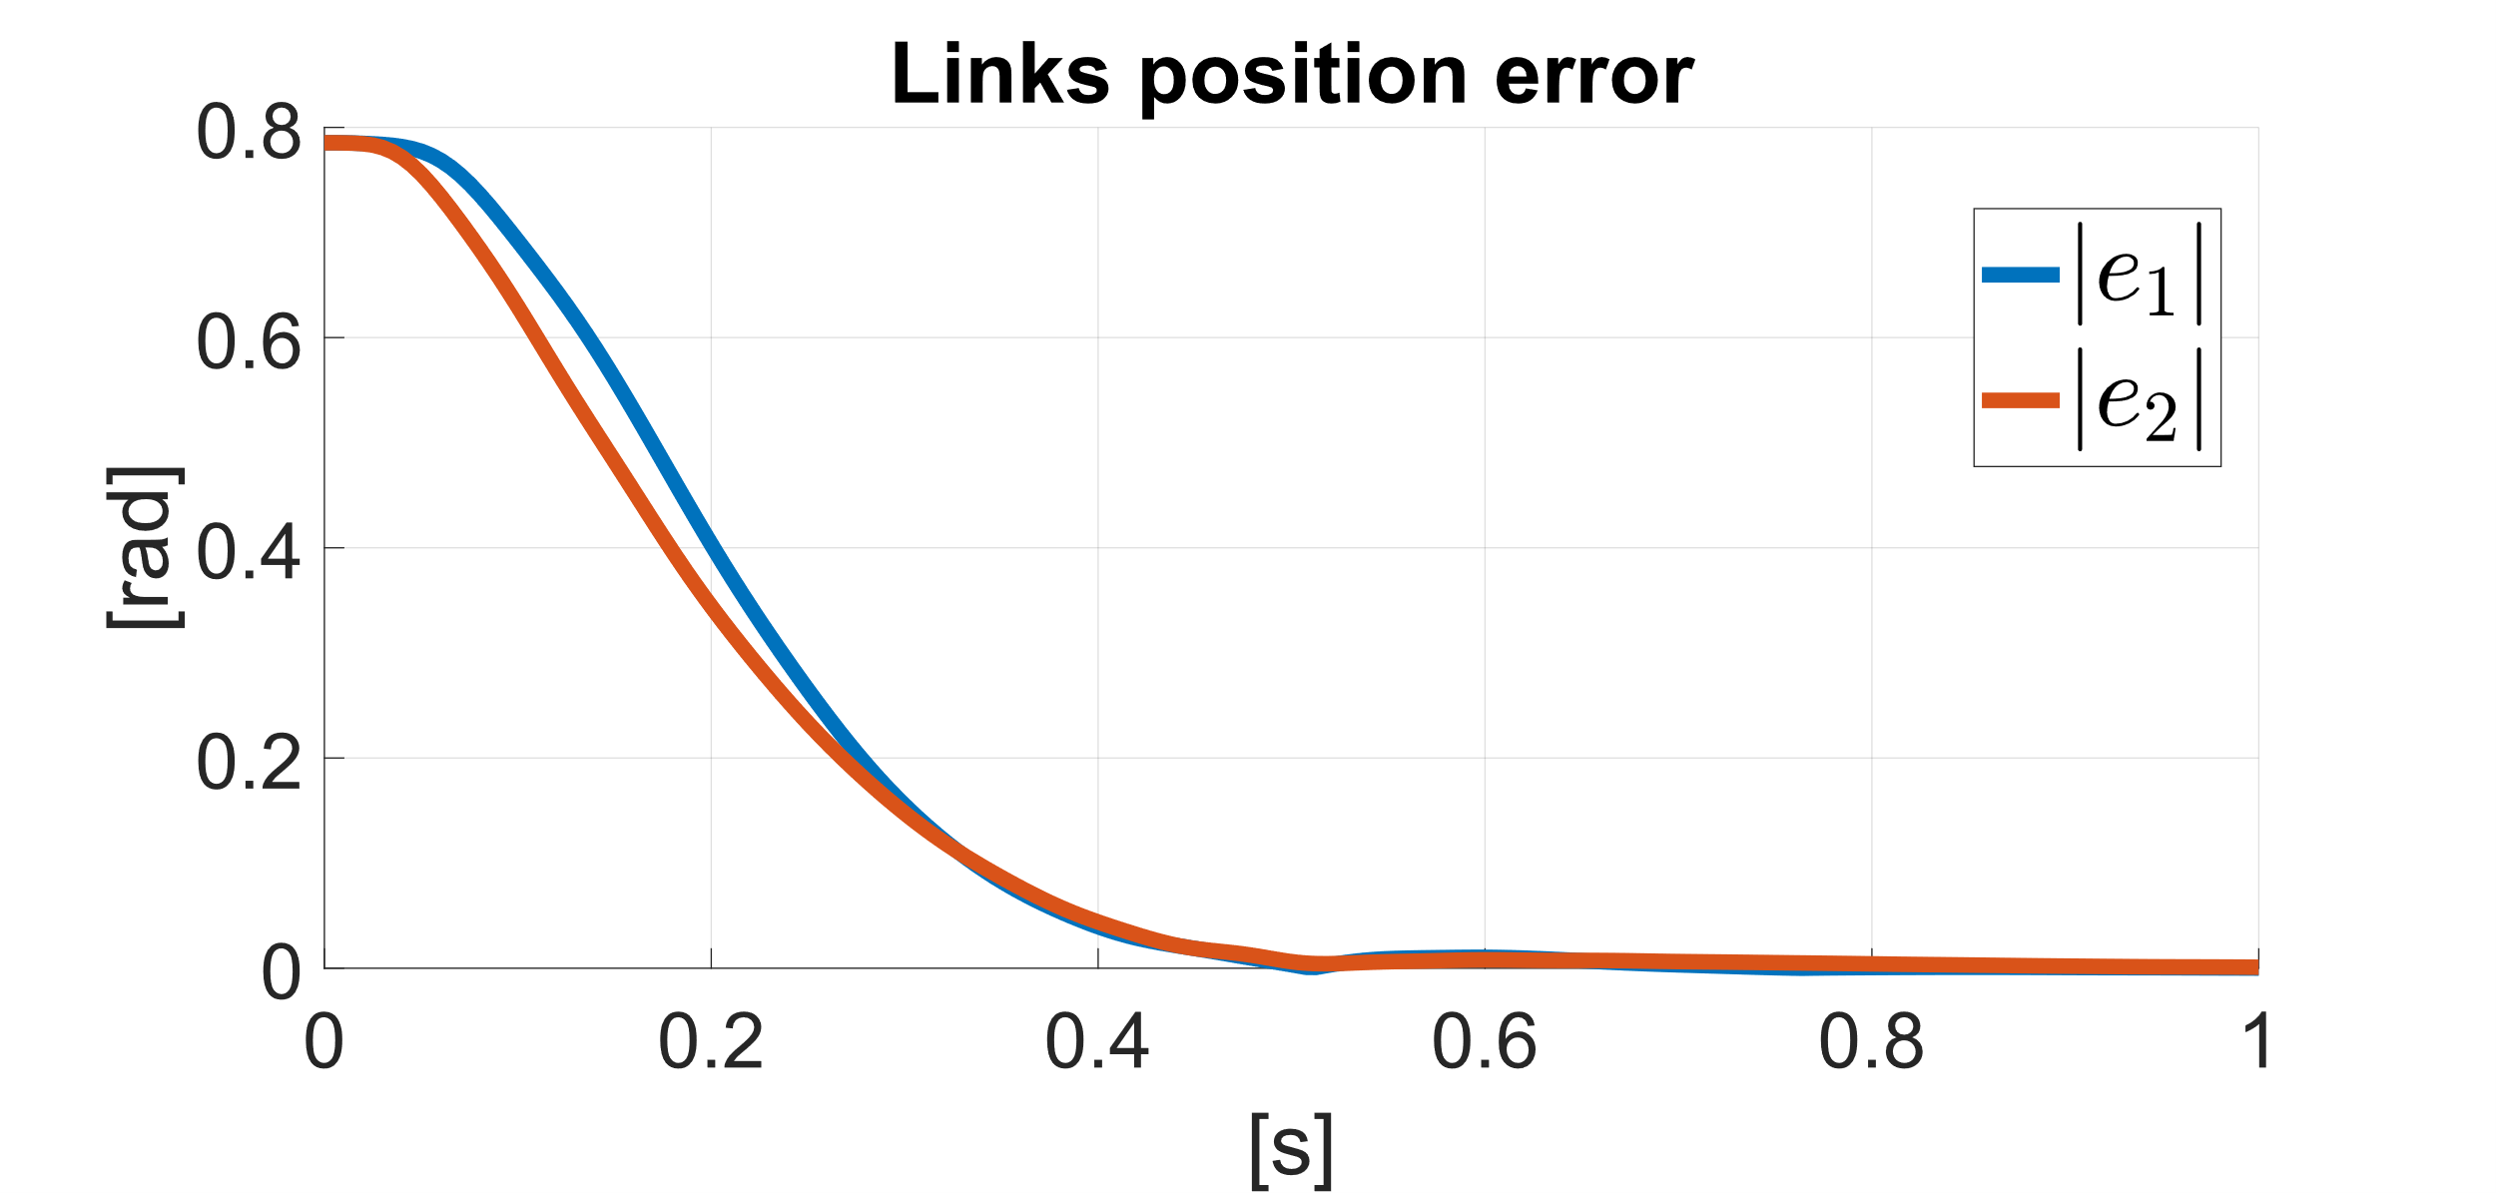
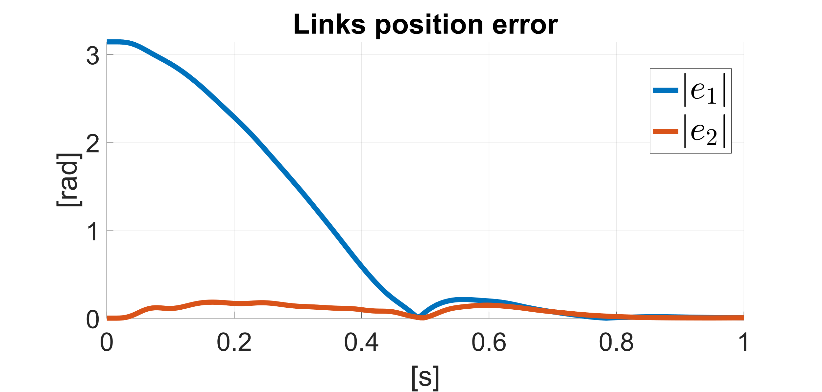
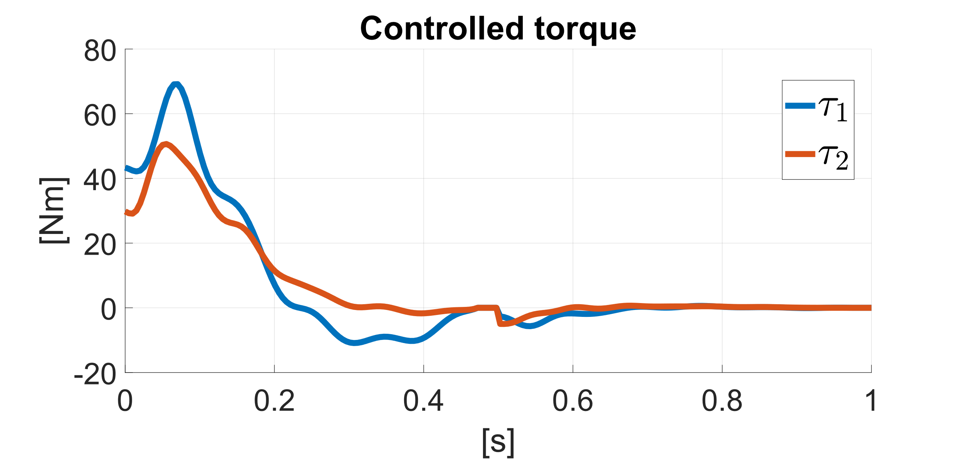
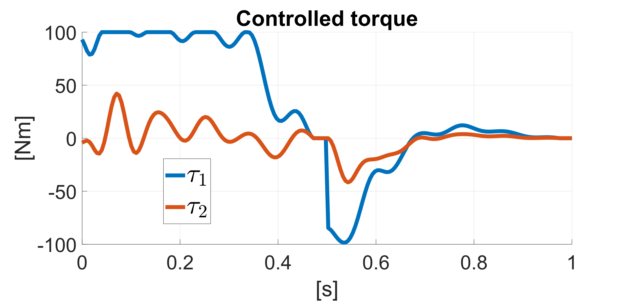
Simulation Results Nominal MPC
Case 1
Case 2

Slide 21
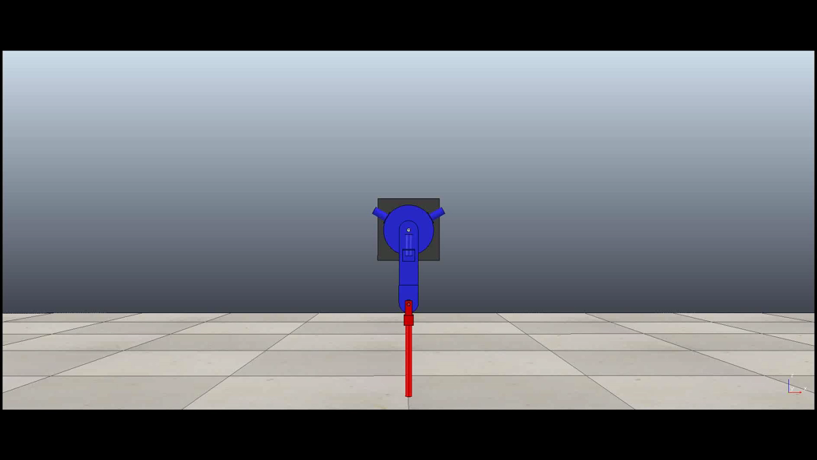
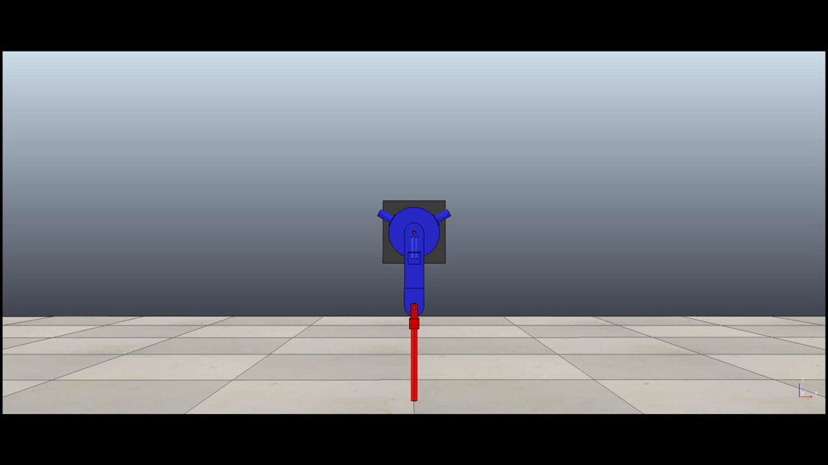
Simulation Results Nominal MPC
Case 1
Case 2

Slide 22
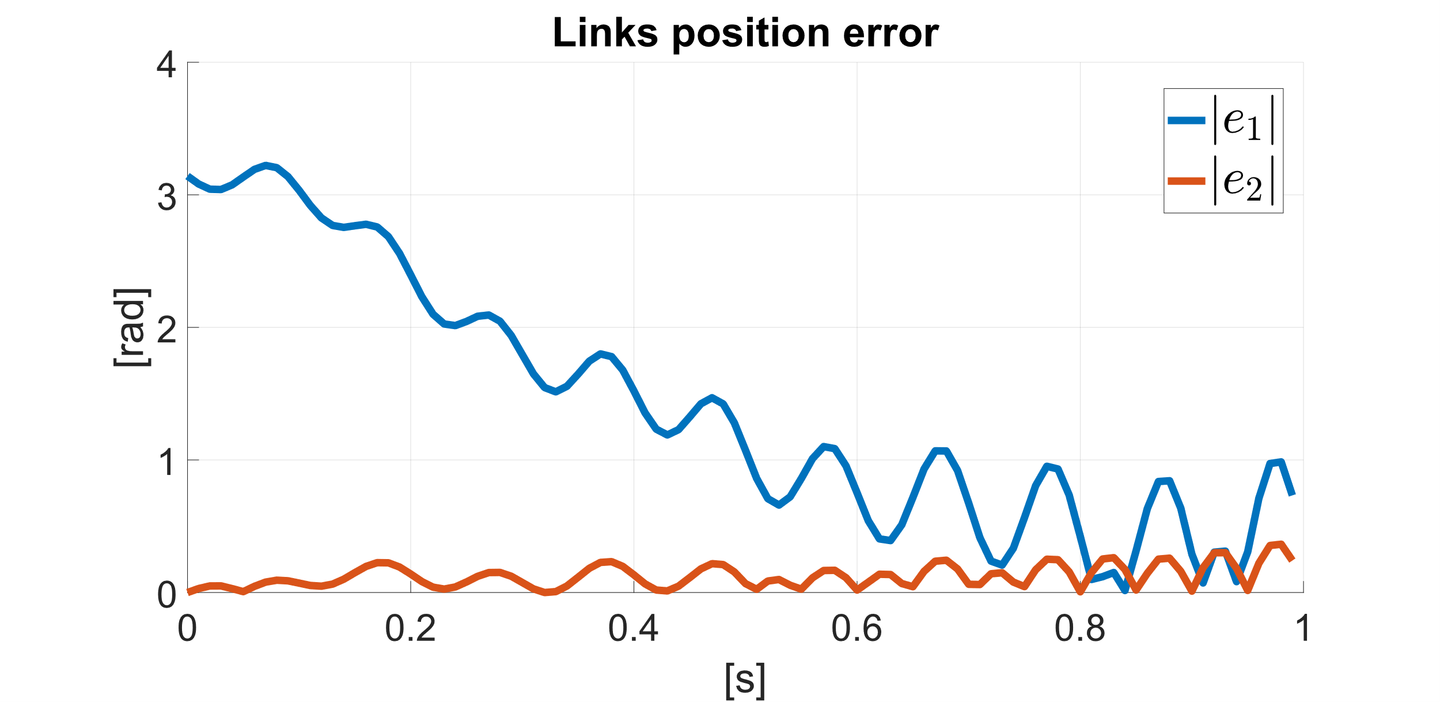
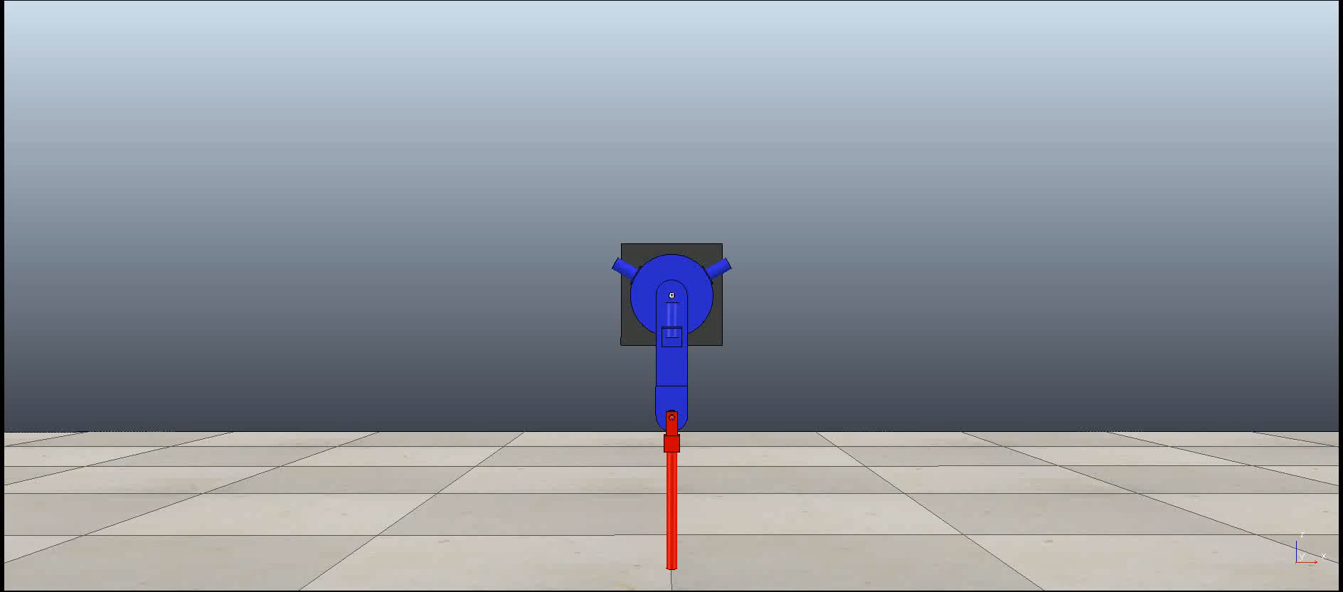
Nominal MPC with Wrong Elasticity
Real: $K_{1}=10^{3},K_{2}=10^{2}$ MPC: $K_{1}=1.2⋅10^{3},K_{2}=1.2⋅10^{2}$
Case 2

Slide 23
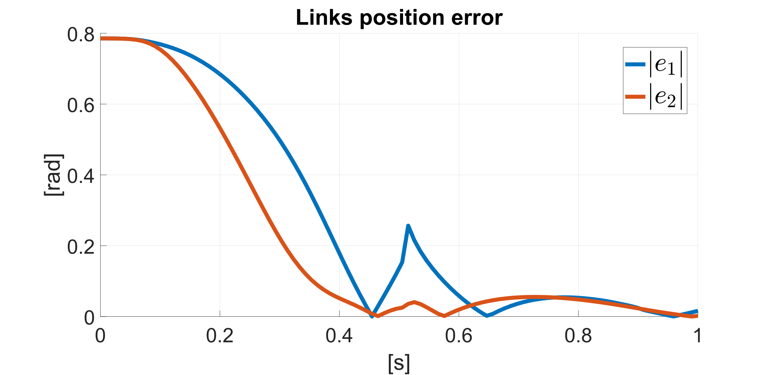
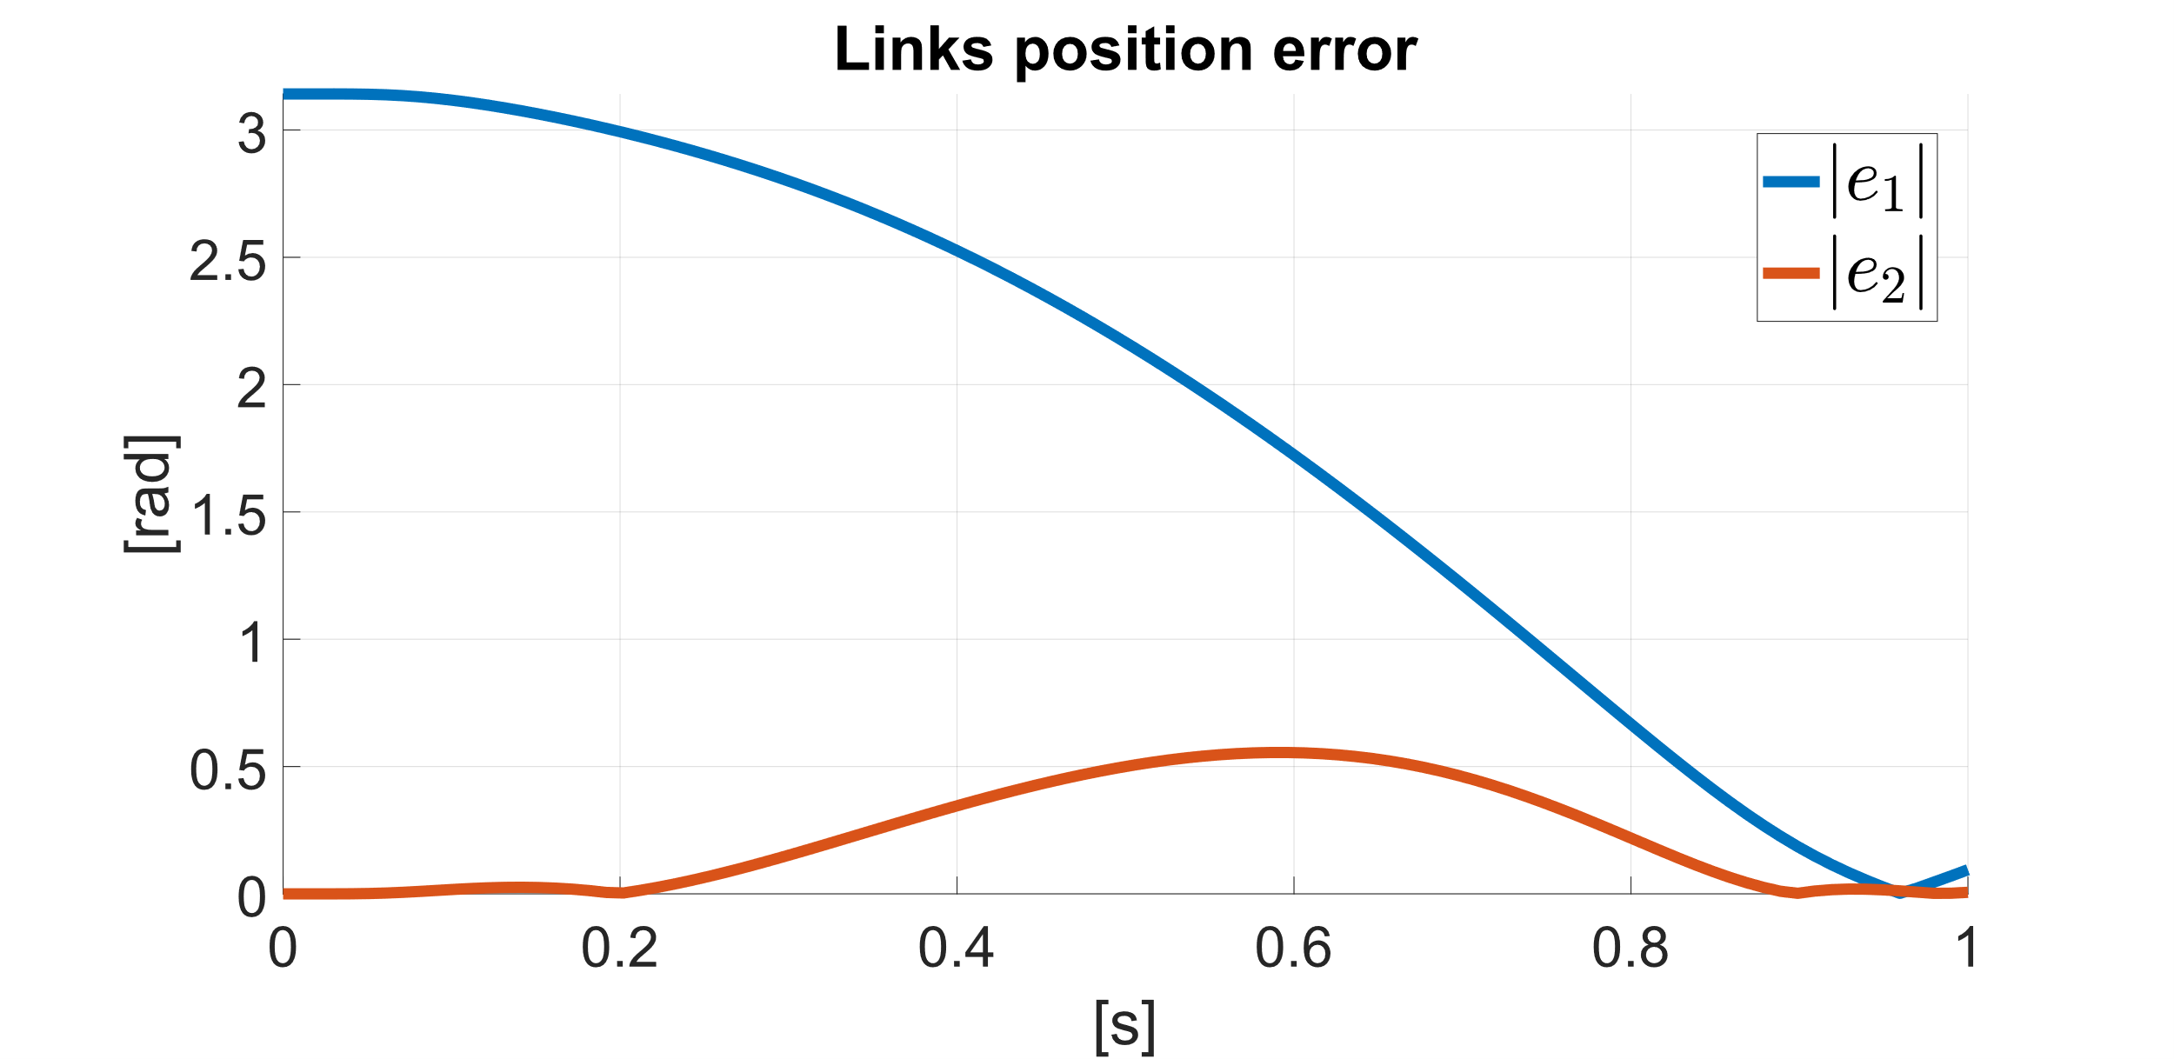
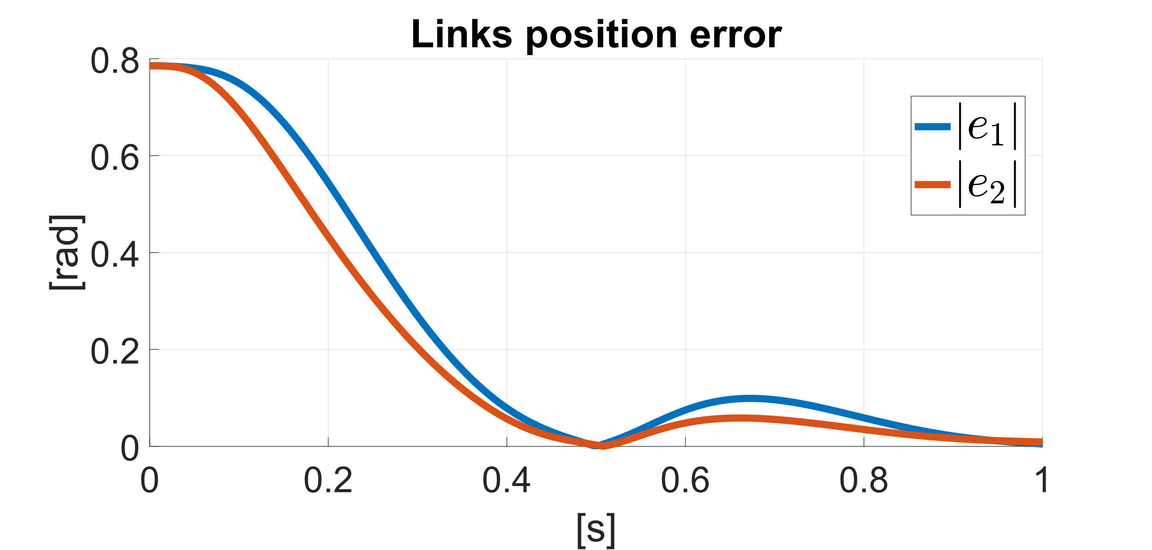
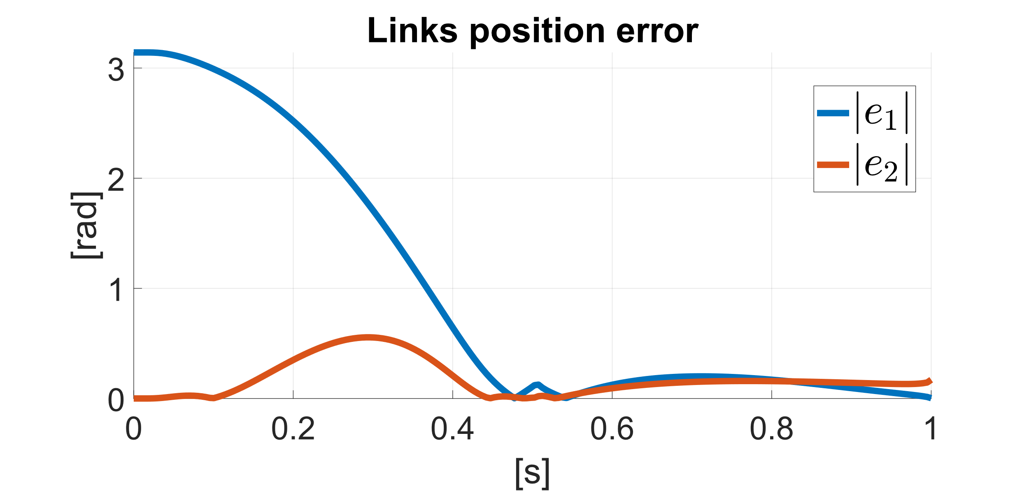
GP Offline Training
Dataset b : 100pt Dataset a :10pt
Case 1
Case 2

Slide 24
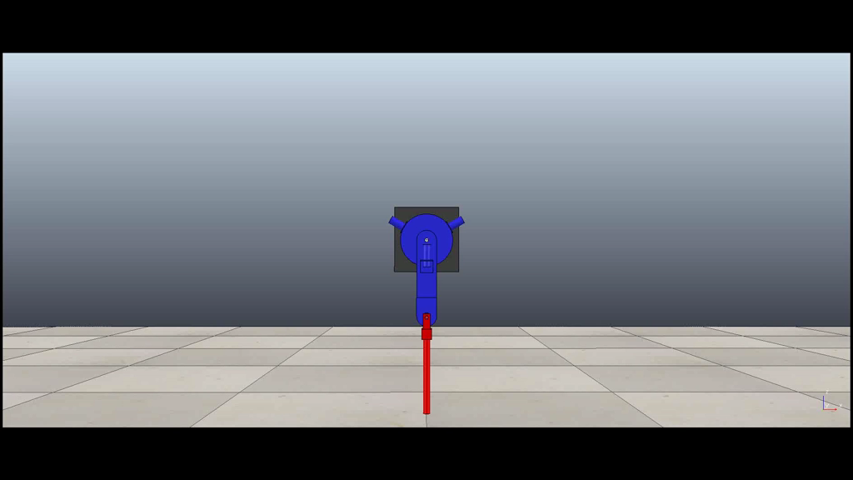

GP Offline Training
Dataset a :10pt
Case 1
Case 2

Slide 25

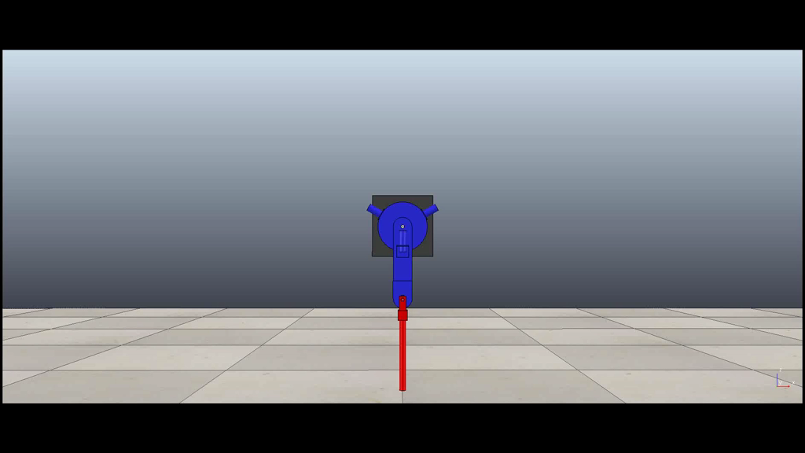
GP Offline Training
Dataset b :100pt
Case 1
Case 2

Slide 26
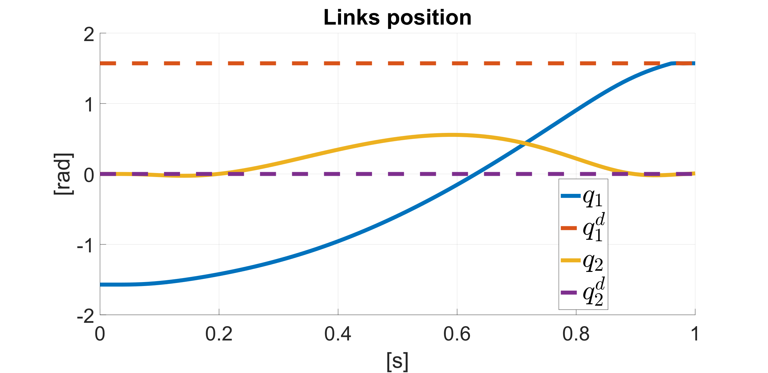
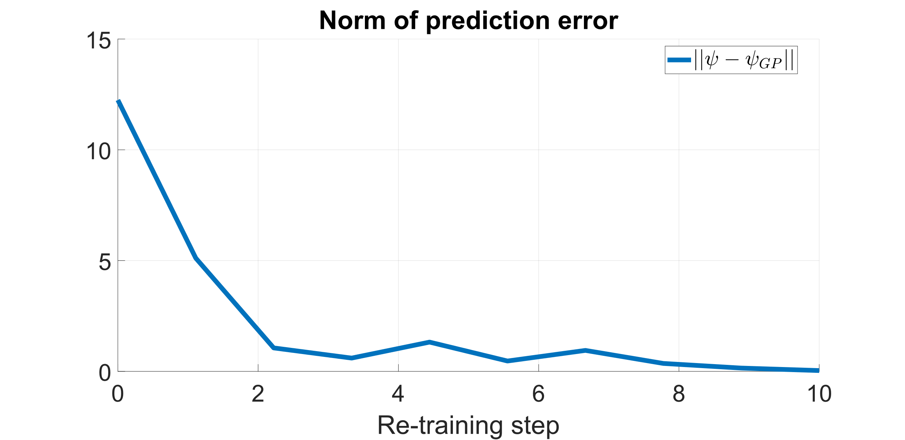
GP Online Training
Evolution of the GP model prediction error throughout the simulation
Dataset initially contains 100 datapoints, and gets augmented 10 times, each time inserting 10 new points, until reaching 200 datapoints

Slide 27
GP Online Training
Case 1
Case 2

Slide 28
Conclusions
Combination of MPC and learning techniques has proven effective, although very demanding on the computational resources
Furthermore, the convergence is strongly related to an accurate tuning of the cost function
Future works
Extension to trajectory tracking
Explicit handling of the sources of instability when combining MPC and learning («extreme configurations»)
Variance-dependent term in the cost function
Enforcing a relatively small elastic displacement
Introduction of probabilistic constraints (chance constraints)

Slide 29
Bibliography
M. Capotondi, G. Turrisi, C. Gaz, V. Modugno, G. Oriolo, and A. De Luca, “An online learning procedure for feedback linearization control without torque measurements,” Conference on Robot Learning, pp. 1359–1368, PMLR, 2020
M. Capotondi, G. Turrisi, C. Gaz, V. Modugno, G. Oriolo, and A. De Luca, “Learning feedback linearization control without torque measurements,” IRIM, 2020
M. W. Spong, “Modeling and control of elastic joint robots,” Journal of Dynamic Systems, Measurement, and Control, 1987
G. Oriolo and Y. Nakamura, “Control of mechanical systems with second-order nonholonomic constraints: Underactuated manipulators,” Conference on Decision and Control, pp. 2398–2403, 1991

Slide 30
Bibliography
A. De Luca, S. Iannitti, R. Mattone, and G. Oriolo, “Control problems in underactuated manipulators,” 2001 IEEE/ASME International Conference on Advanced Intelligent Mechatronics. Proceedings (Cat. No. 01TH8556), vol. 2, pp. 855–861, IEEE, 2001
I. Fantoni, R. Lozano, and S. Sinha, “Nonlinear control for underactuated mechanical systems,” Appl. Mech. Rev., vol. 55, no. 4, pp. B67–B68, 2002
A. Bemporad, “Model predictive control.” - Course slides, 2020
D. Mayne, “An apologia for stabilising terminal conditions in model predictive control,” International Journal of Control, vol. 86, 11 2013
A. D. Luca, “A review on the control of flexible joint manipulators,” Workshop on Soft Robotic Modeling and Control, 2018
P. Tomei, “A simple pd controller for robots with elastic joints,” IEEE Transactions on automatic control, vol. 36, no. 10, pp. 1208–1213, 1991.

